Slide 1


Slide 2
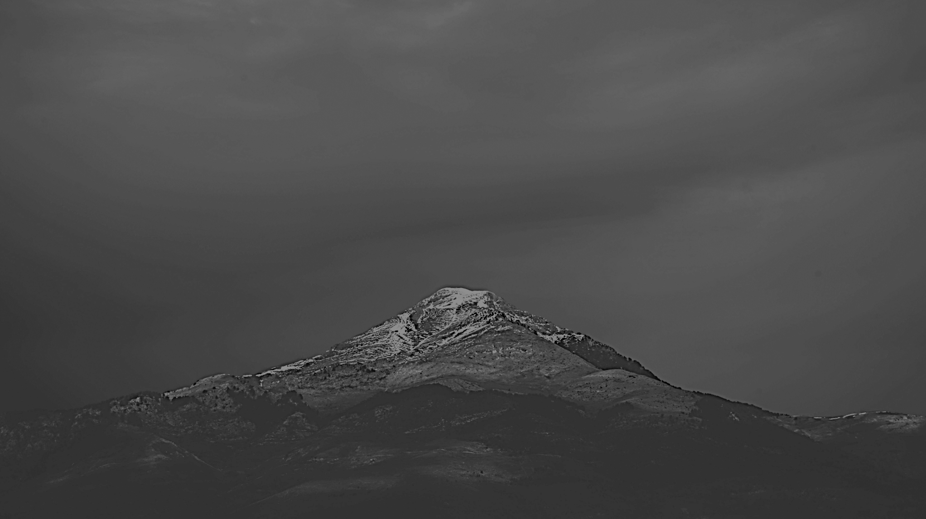
Romans 1:17
For in it the righteousness of God is revealed from faith to faith; as it is written, “But the righteous man shall live by faith.”

Slide 3
Matthew 13:58
And He did not do many miracles there because of their unbelief.

Slide 4

HOW CAN THE BELIEVER KNOW THAT HE IS LIVING BY FAITH?
“THE FOUR TESTS OF FAITH”
A Test That Christians Can Apply To Their Decisions and Actions.

Slide 5
“THE FOUR TESTS OF FAITH”
A Test That Christians Can Apply To Their Decisions and Actions.
TEST #1
AM I DOING THIS FOR THE GLORY OF GOD, OR TO PLEASE MYSELF?
Romans 4:20 yet, with respect to the promise of God, he did not waver in unbelief but grew strong in faith, giving glory to God,

Slide 6
“THE FOUR TESTS OF FAITH”
A Test That Christians Can Apply To Their Decisions and Actions.
TEST #1
AM I DOING THIS FOR THE GLORY OF GOD, OR TO PLEASE MYSELF?
Luke 1:37 For nothing will be
impossible with God.”

Slide 7
“THE FOUR TESTS OF FAITH”
A Test That Christians Can Apply To Their Decisions and Actions.
TEST #1
AM I DOING THIS FOR THE GLORY OF GOD, OR TO PLEASE MYSELF?
Matthew 19:26 Jesus said, “With people this is impossible, but with God all things are possible.”

Slide 8
“THE FOUR TESTS OF FAITH”
A Test That Christians Can Apply To Their Decisions and Actions.
TEST #1
AM I DOING THIS FOR THE GLORY OF GOD, OR TO PLEASE MYSELF?
Romans 4:21 and being fully assured that what God had promised, He was able also to perform.

Slide 9
“THE FOUR TESTS OF FAITH”
A Test That Christians Can Apply To Their Decisions and Actions.
TEST #2
AM I RUSHING AHEAD RASHLY, OR AM I WILLING TO WAIT?
Romans 10:11 For the Scripture says, “Whoever believes in Him will not be disappointed.”

Slide 10
“THE FOUR TESTS OF FAITH”
A Test That Christians Can Apply To Their Decisions and Actions.
TEST #2
AM I RUSHING AHEAD RASHLY, OR AM I WILLING TO WAIT?
Isaiah 28:16 Therefore thus says the Lord God, “Behold, I am laying in Zion a stone, a tested stone, a costly cornerstone for the foundation, firmly placed. He who believes in it will not be disturbed.

Slide 11
“THE FOUR TESTS OF FAITH”
A Test That Christians Can Apply To Their Decisions and Actions.
TEST #2
AM I RUSHING AHEAD RASHLY, OR AM I WILLING TO WAIT?
Romans 14:23 But he who doubts is condemned if he eats, because his eating is not from faith; and whatever is not from faith is sin.

Slide 12
“THE FOUR TESTS OF FAITH”
A Test That Christians Can Apply To Their Decisions and Actions.
TEST #3
CAN I DEFEND WHAT I AM DOING FROM THE WORD OF GOD?
Romans 10:17 So faith comes from hearing, and hearing by the word of Christ.

Slide 13
“THE FOUR TESTS OF FAITH”
A Test That Christians Can Apply To Their Decisions and Actions.
TEST #4
AS I CONSIDER THIS MOVE, DO I HAVE JOY AND PEACE WITHIN?
Romans 15:13 Now may the God of hope fill you with all joy and peace in believing, so that you will abound in hope by the power of the Holy Spirit

Slide 14
“THE FOUR TESTS OF FAITH”
A Test That Christians Can Apply To Their Decisions and Actions.
TEST #4
AS I CONSIDER THIS MOVE, DO I HAVE JOY AND PEACE WITHIN?
Colossians 3:15 Let the peace of
Christ rule in your hearts…

Slide 15
#1 Did Abraham marry Hagar that he might glorify God?

Slide 16
#2 Were Abraham and Sarah
willing to wait?

Slide 17
#3 Could they base their decision on the revealed Word of God?

Slide 18
#4 Finally, was there joy and peace because of their decision?

Slide 19
If we seek the glory of God…
If we patiently wait on God…
If we follow the Word of God…
If we enjoy God’s joy and peace within…
  Then we can be sure we are
  living ACCORDING TO faith.

Slide 20
What Must I Do To Be Saved?
Hear and Learn – Rom. 10:17; John 6:45; 17:3
Believe – Heb. 11:6; John 6:29; 8:24
Confess the Lord – Matt. 10:32-33; Rom. 10:9-10
Repent – Luke 13:3; Acts 3:19; 17:30
Be Baptized – Mark 16:16; Acts 22:16; Gal. 3:26-27; 1 Pet. 3:21
Be Faithful Unto Death – Revelation 2:10
Go and Share the Good News!
Matthew 28:18-20; Mark 16:15-16

